Slide 1

Lions Practical Technology
October 2022

Slide 2
How do Lions use Technology?
Communication
Administration
Public Relations
Promotion

Slide 3


How are you currently using technology to support Lions?

Slide 4
Technology Tools - Agenda
Google
Social Media
MailChimp
File storage and sharing
Virtual Meetings (revisited)
Additional Tools

Slide 5


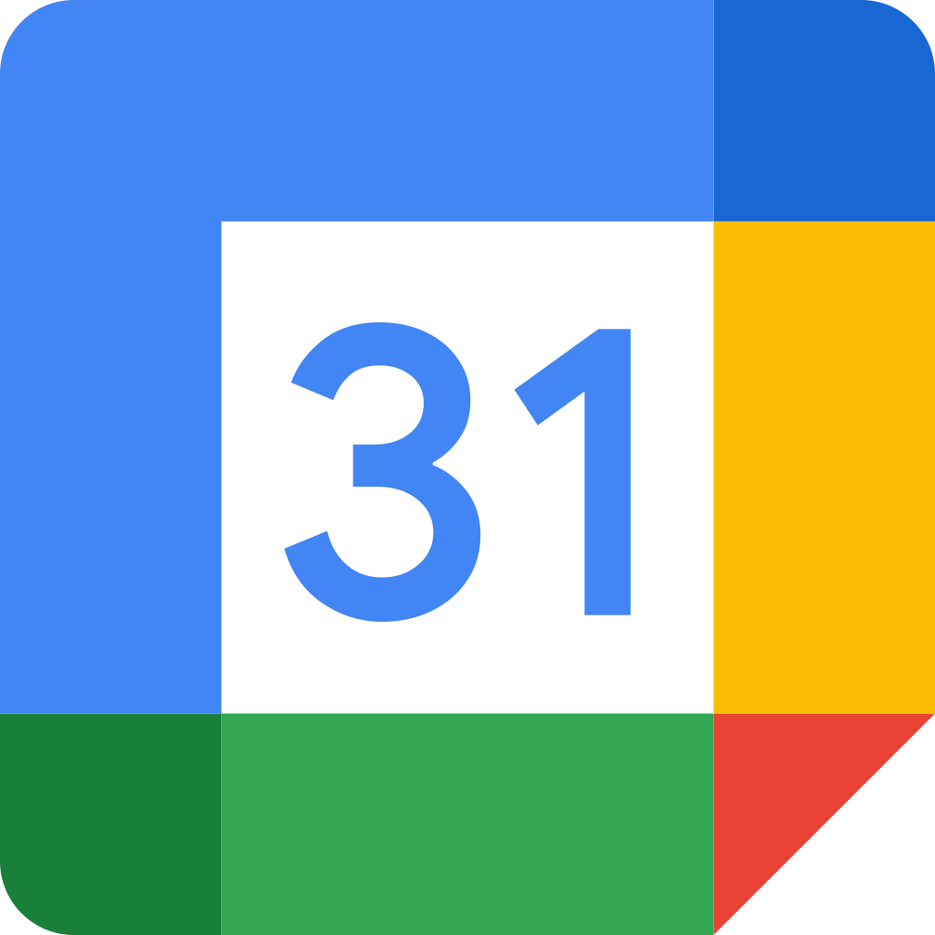


Google
Technology
Toolkit

Slide 6
Google
Google email
Google groups
Google photos
Google documents
YouTube videos
Google sites
Google Drive
Google Calendar
Google Maps

Slide 7
Google - Benefits
One account for lots of capabilities
Free (to a point)
Proven
Supported
Secure
hersheylions@gmail.com

Slide 8
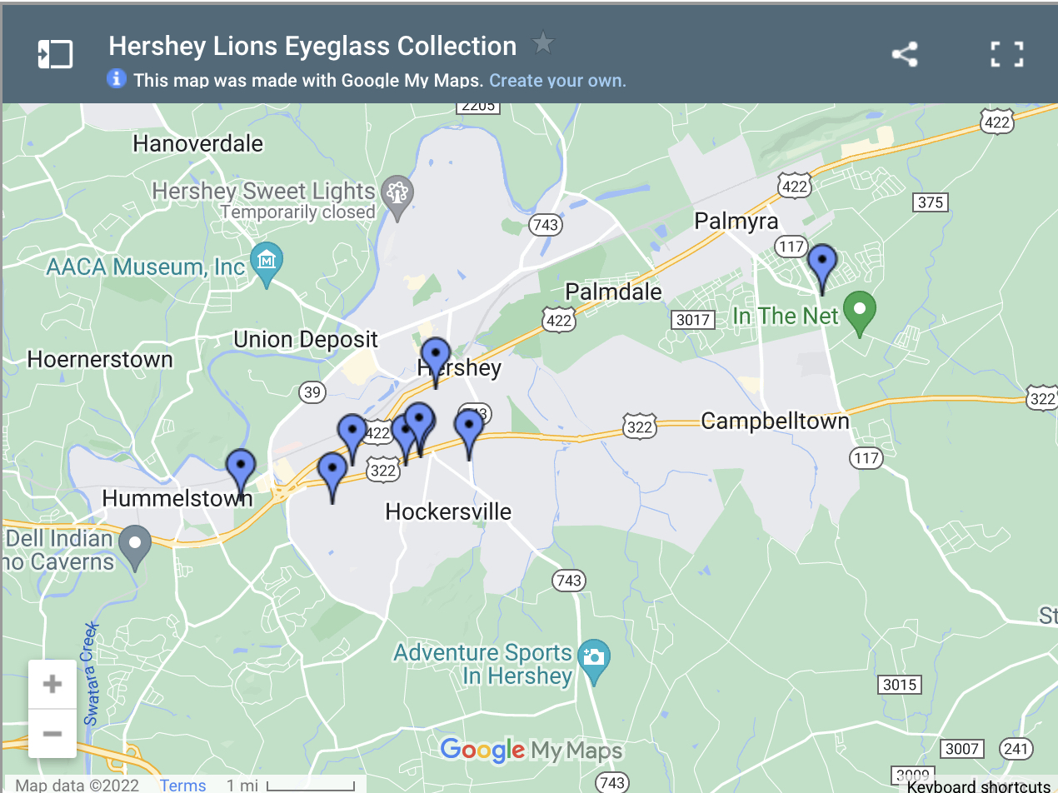
Google - Uses
Google Photos – store, share club/district photos
Gmail – club/district email address
Calendar – club/district calendar internal/external
Drive – store club/district documents
Groups – create mail groups for mailing (more in MailChimp later)
Google Docs – collaborate/share creating/updating documents (MS Word not required)
Google Maps - custom map for location of eyeglass boxes

Slide 9
Google – Getting Started
Create account
Identify needs for your club or district
Try services one by one (prioritize)
Expand as you get more comfortable

Slide 10
Google – Considerations
Managing account/sharing
  Can share password with others, but there are added steps
Storage limitations (planning)
  Free – 15 gigabytes – Drive, Gmail, Photos
  100 gigabytes - $1.99/month
  200 gigabytes - $2.99/month

Slide 11




Social Media
Start a conversation (or two)

Slide 12
Social Media
Why use Social Media?
Social Media Channels
Community Engagement
Publish events
Share the Lions message and experience with others
Connect with other Lions, Clubs, Districts, LCI
Facebook Page, Groups
LCI Facebook Groups
Twitter
Instagram
YouTube
LinkedIn

Slide 13





Social Media - Breakdown
Facebook Pages – lots of people here, sharing increases reach, see how many have viewed posts, events, advertising, likes, Facebook Live
Twitter – open to everyone, hashtags can “trend”, easily searchable on internet, followers (similar to likes)
Instagram – photo-centric, color filters, followers
YouTube - “free” video storage, subscribers, highly used search
LinkedIn – more professional, articles, postings, spread Lionism through professional connections

Slide 14
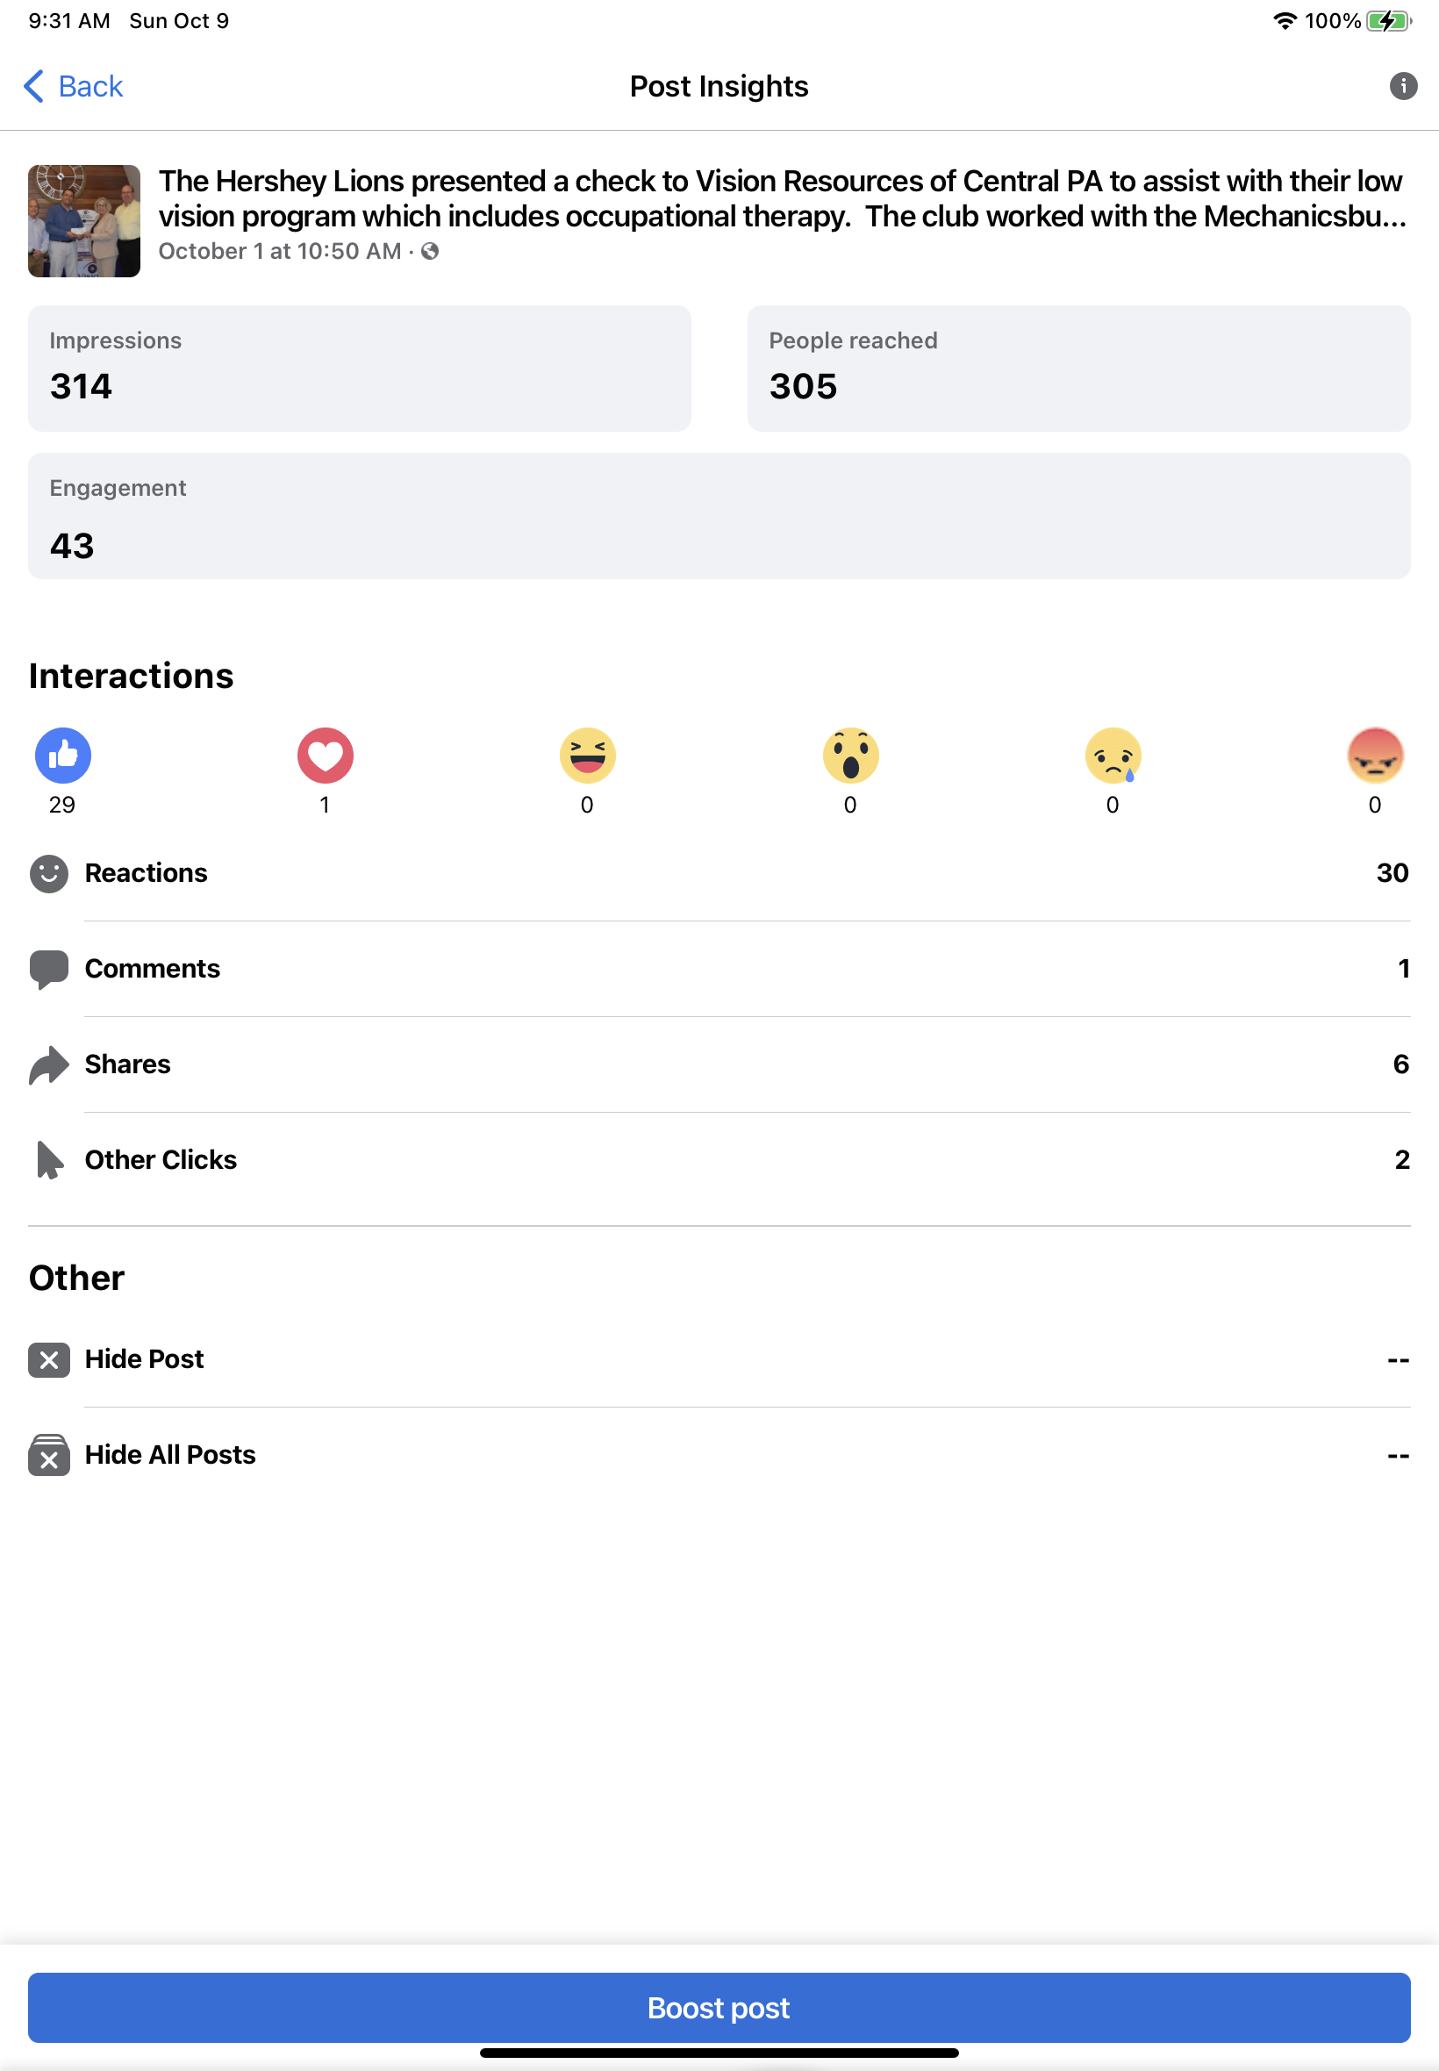
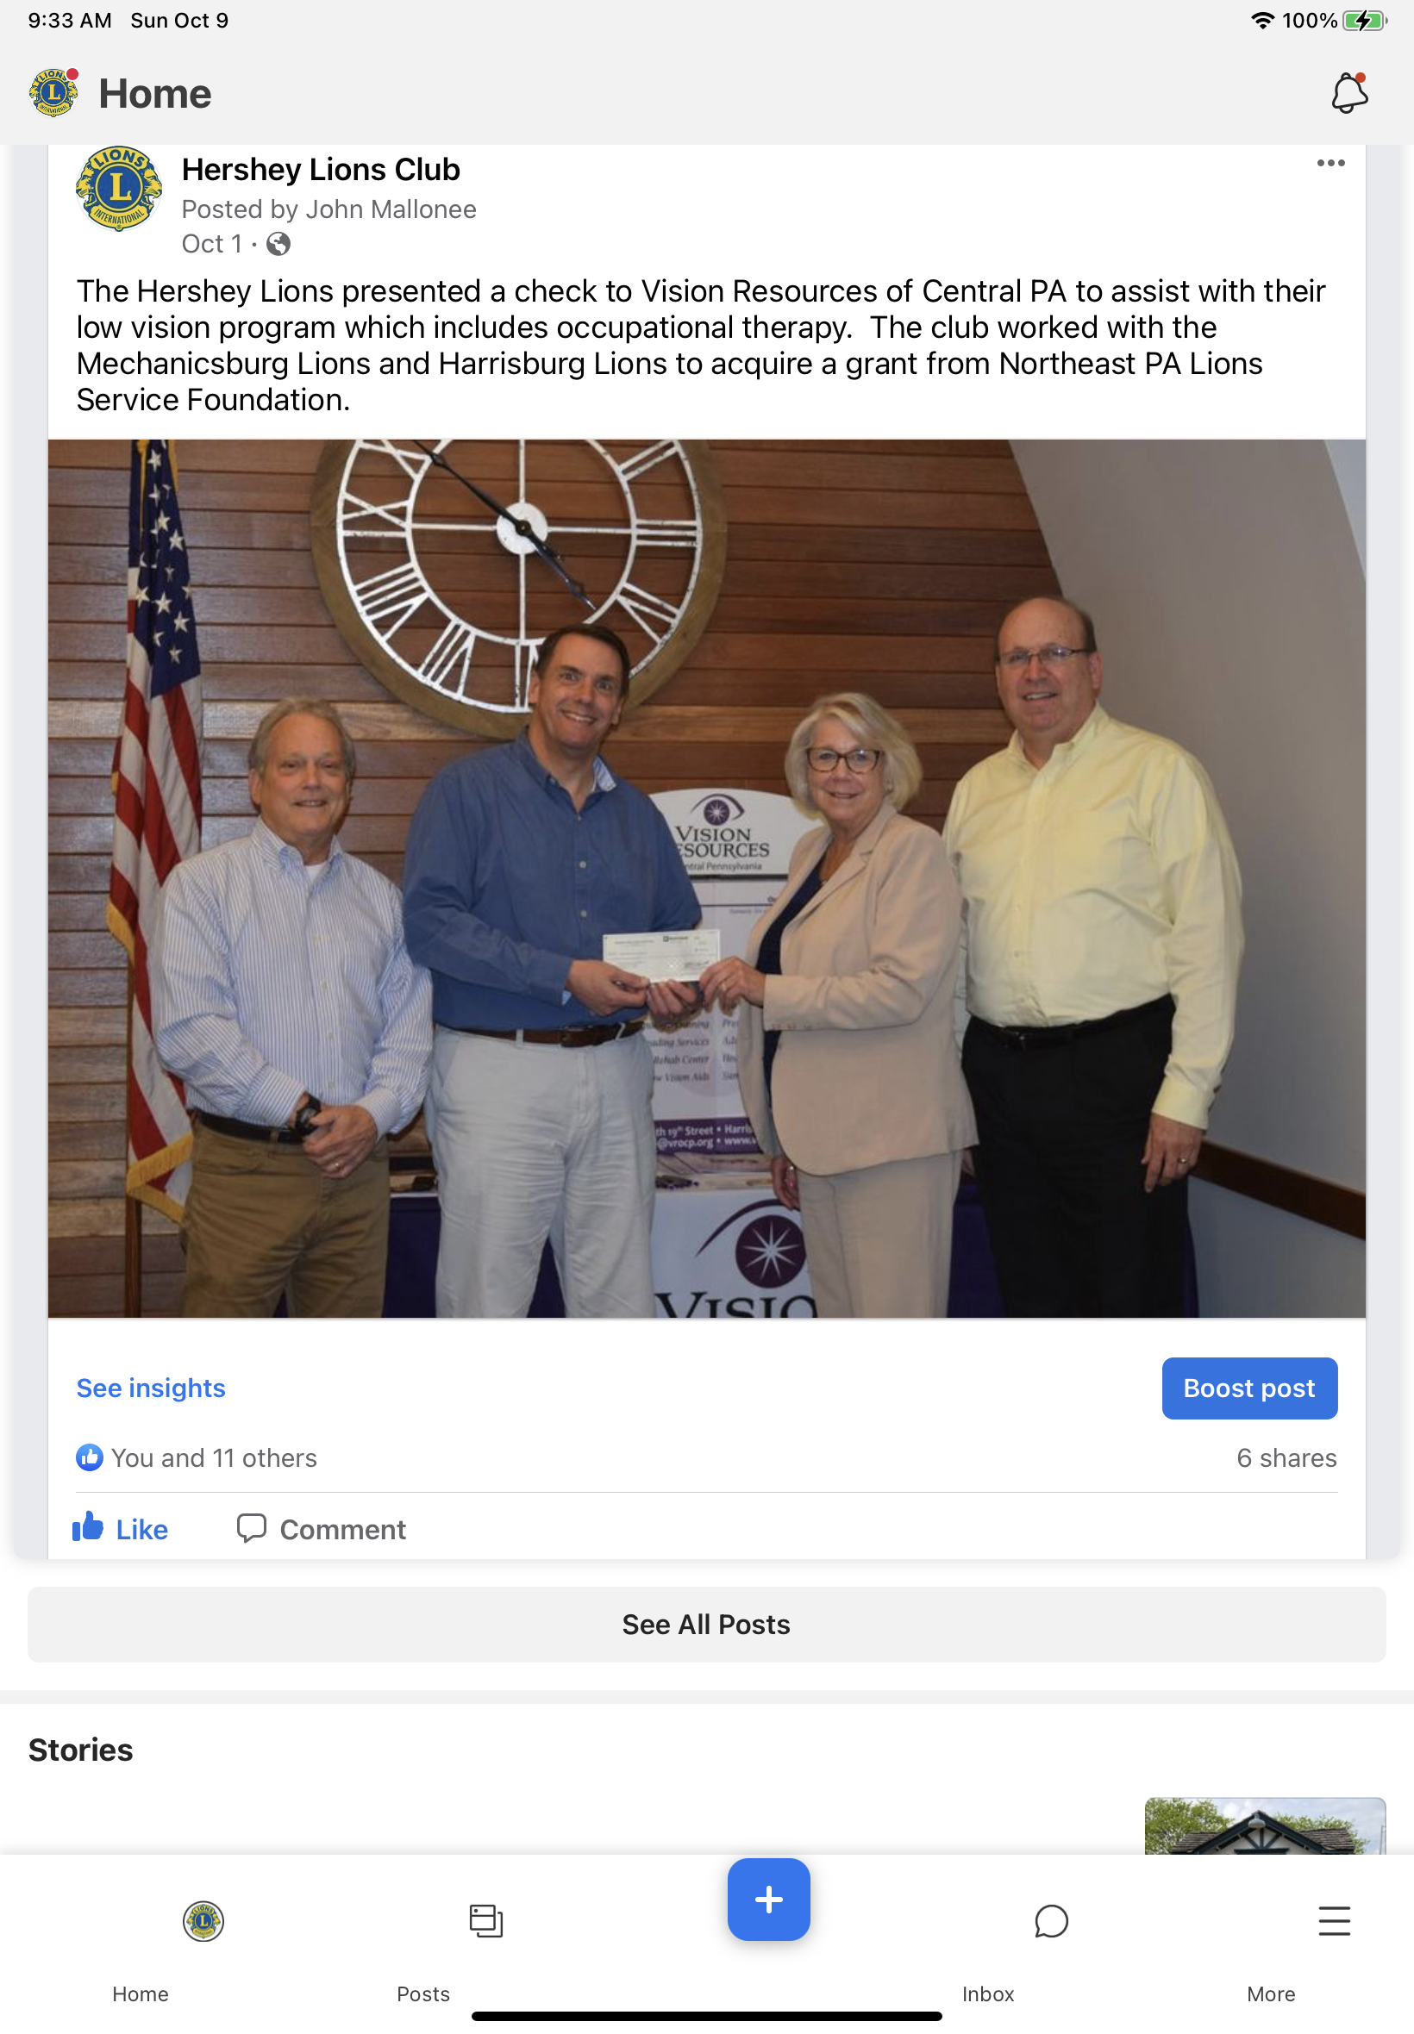
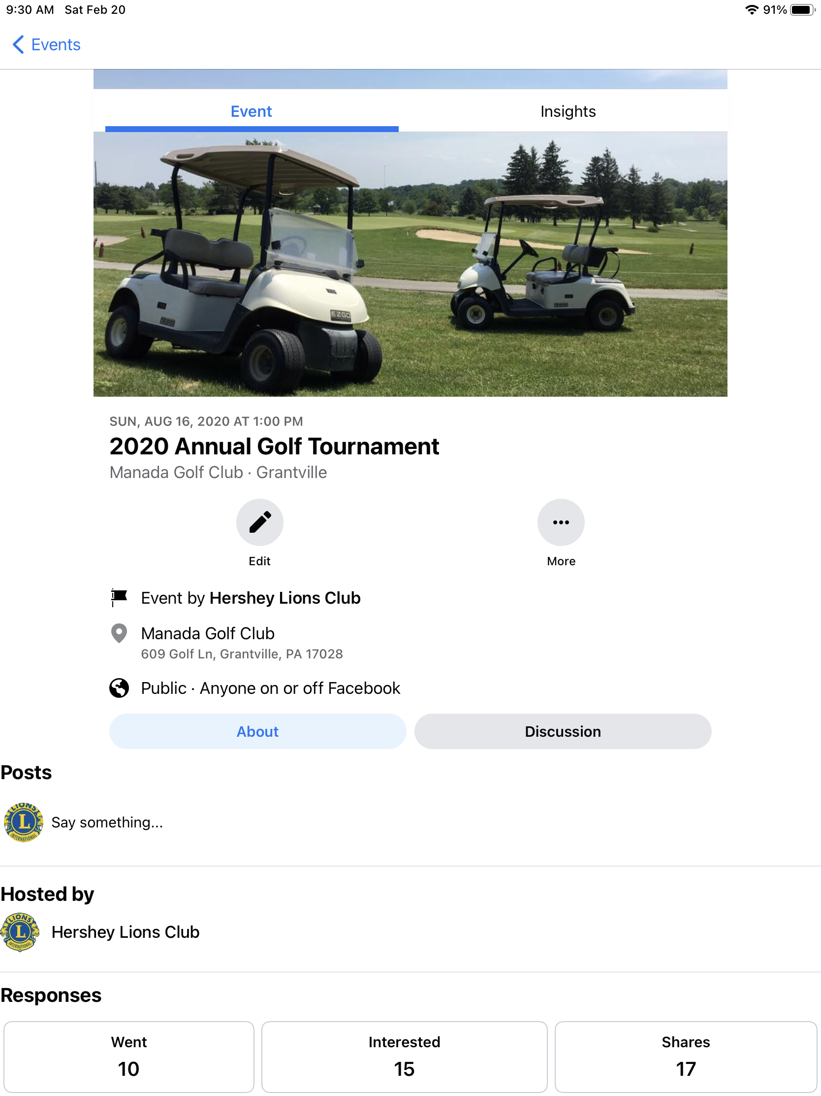
Social Media - Examples

Slide 15
Social Media – LCI
Facebook Groups/Pages
Why Connect
Global Lions Forum – public group
Lions Clubs Help and Support Group – public group
Lions Global Action Team – private group
MyLion Forum – private group
Lions Clubs International - page
Get ideas
Meet other Lions
Ask a question
Keep up with current events
More!

Slide 16
Social Media – Ideas
Ideas
Additional Thoughts
Donate Button
Tagging
Facebook fundraisers
Events
Advertisements
Sharing
Likes on other pages (Lions, Community)
Tell a story
Use photos and videos to support your story
Target your story to your audience
Different social media channels require different approaches

Slide 17


Social Media Workshop
Description
You have agreed to be your club chairperson to organize, plan, and execute a new fundraiser. How can you use social media to help you? Be as specific as you can.

Slide 18

MailChimp
Email Marketing and Communication

Slide 19
MailChimp
What is it?
Why use it?
Group/Mass email
Build and cultivate your audience
Used for marketing, but can also be used for communication
Large mail lists (avoid email from going to SPAM)
Attractive email
Ability to unsubscribe
Ability to see who reads your email and clicks on links within your email

Slide 20
MailChimp
Free Version
Terms/Features
10,000 emails/month
2000 subscribers
Beyond 2000 subscribers, monthly fee starts at $29.99
Audience – 1 for free accounts
Tags – create “sub-lists” for your Audience
Campaigns – communication/marketing campaigns
Reusable templates
Upload files (instead of attachments)

Slide 21
MailChimp
Getting Started
Examples
Club notifications and email
Club newsletter
District newsletter
Club member birthday email
Prospective members
Sign up for free account
Enter or import an Audience
Build your profile (logo, name, address, etc.)
Build your first communication (TO:, Subject, content)
Send your first communication
Experiment

Slide 22
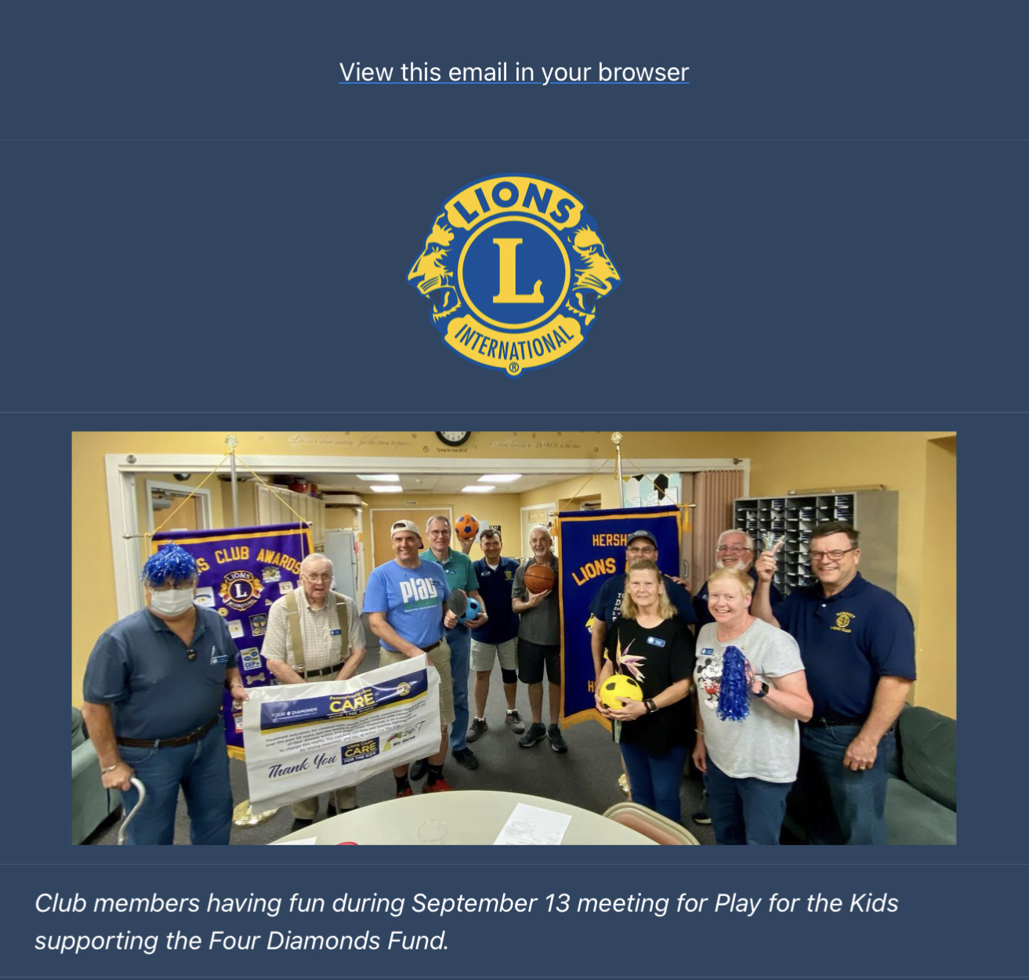
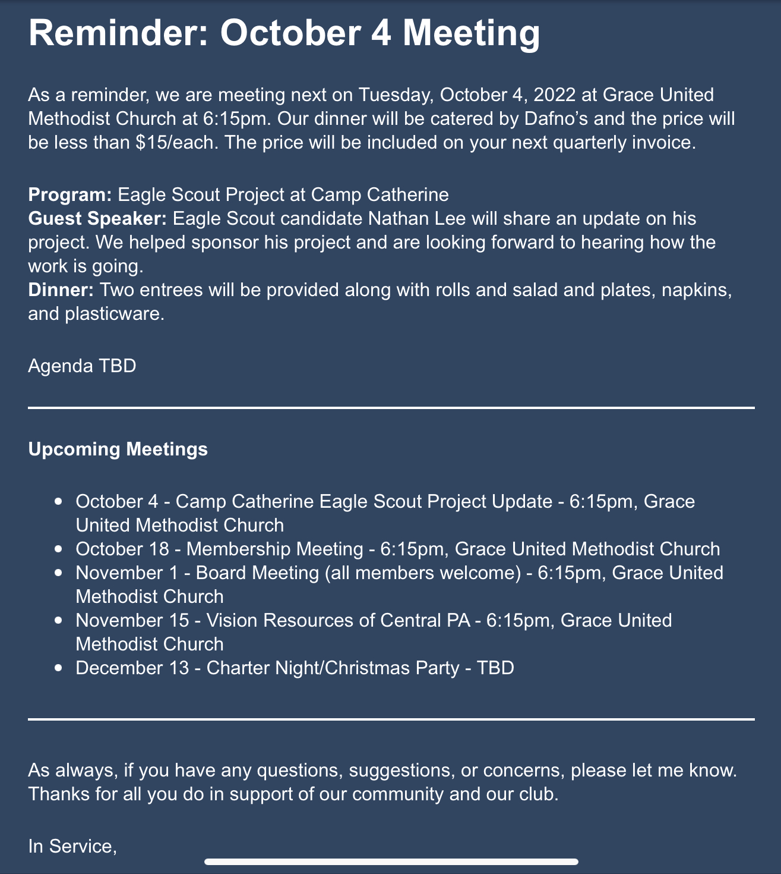
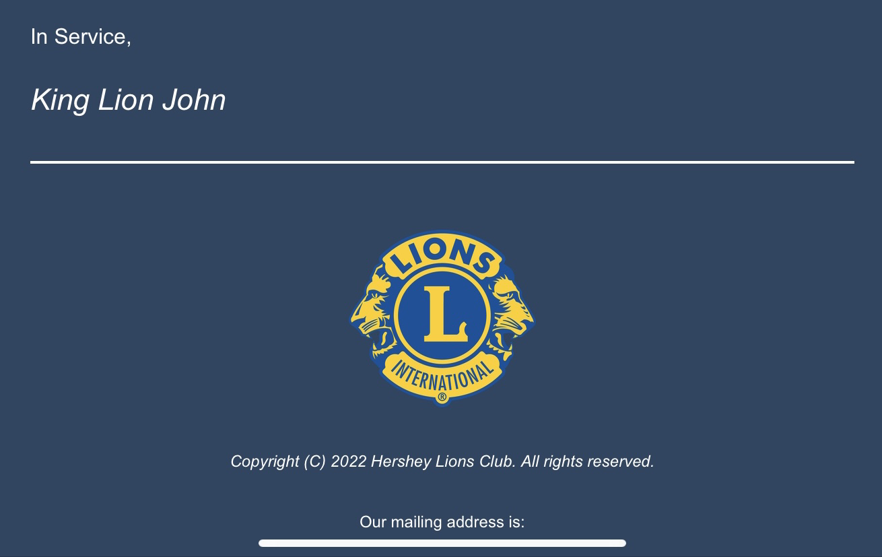
MailChimp - Examples

Slide 23
MailChimp
Tips
Tips
Import users from LCI export
Post to Social Media
Mobile App
Use Test Email
View a demo or ask for help
Consider re-sending unopened mail
Respect un-subscribers
Use Replicate feature for similar communications/ campaigns

Slide 24
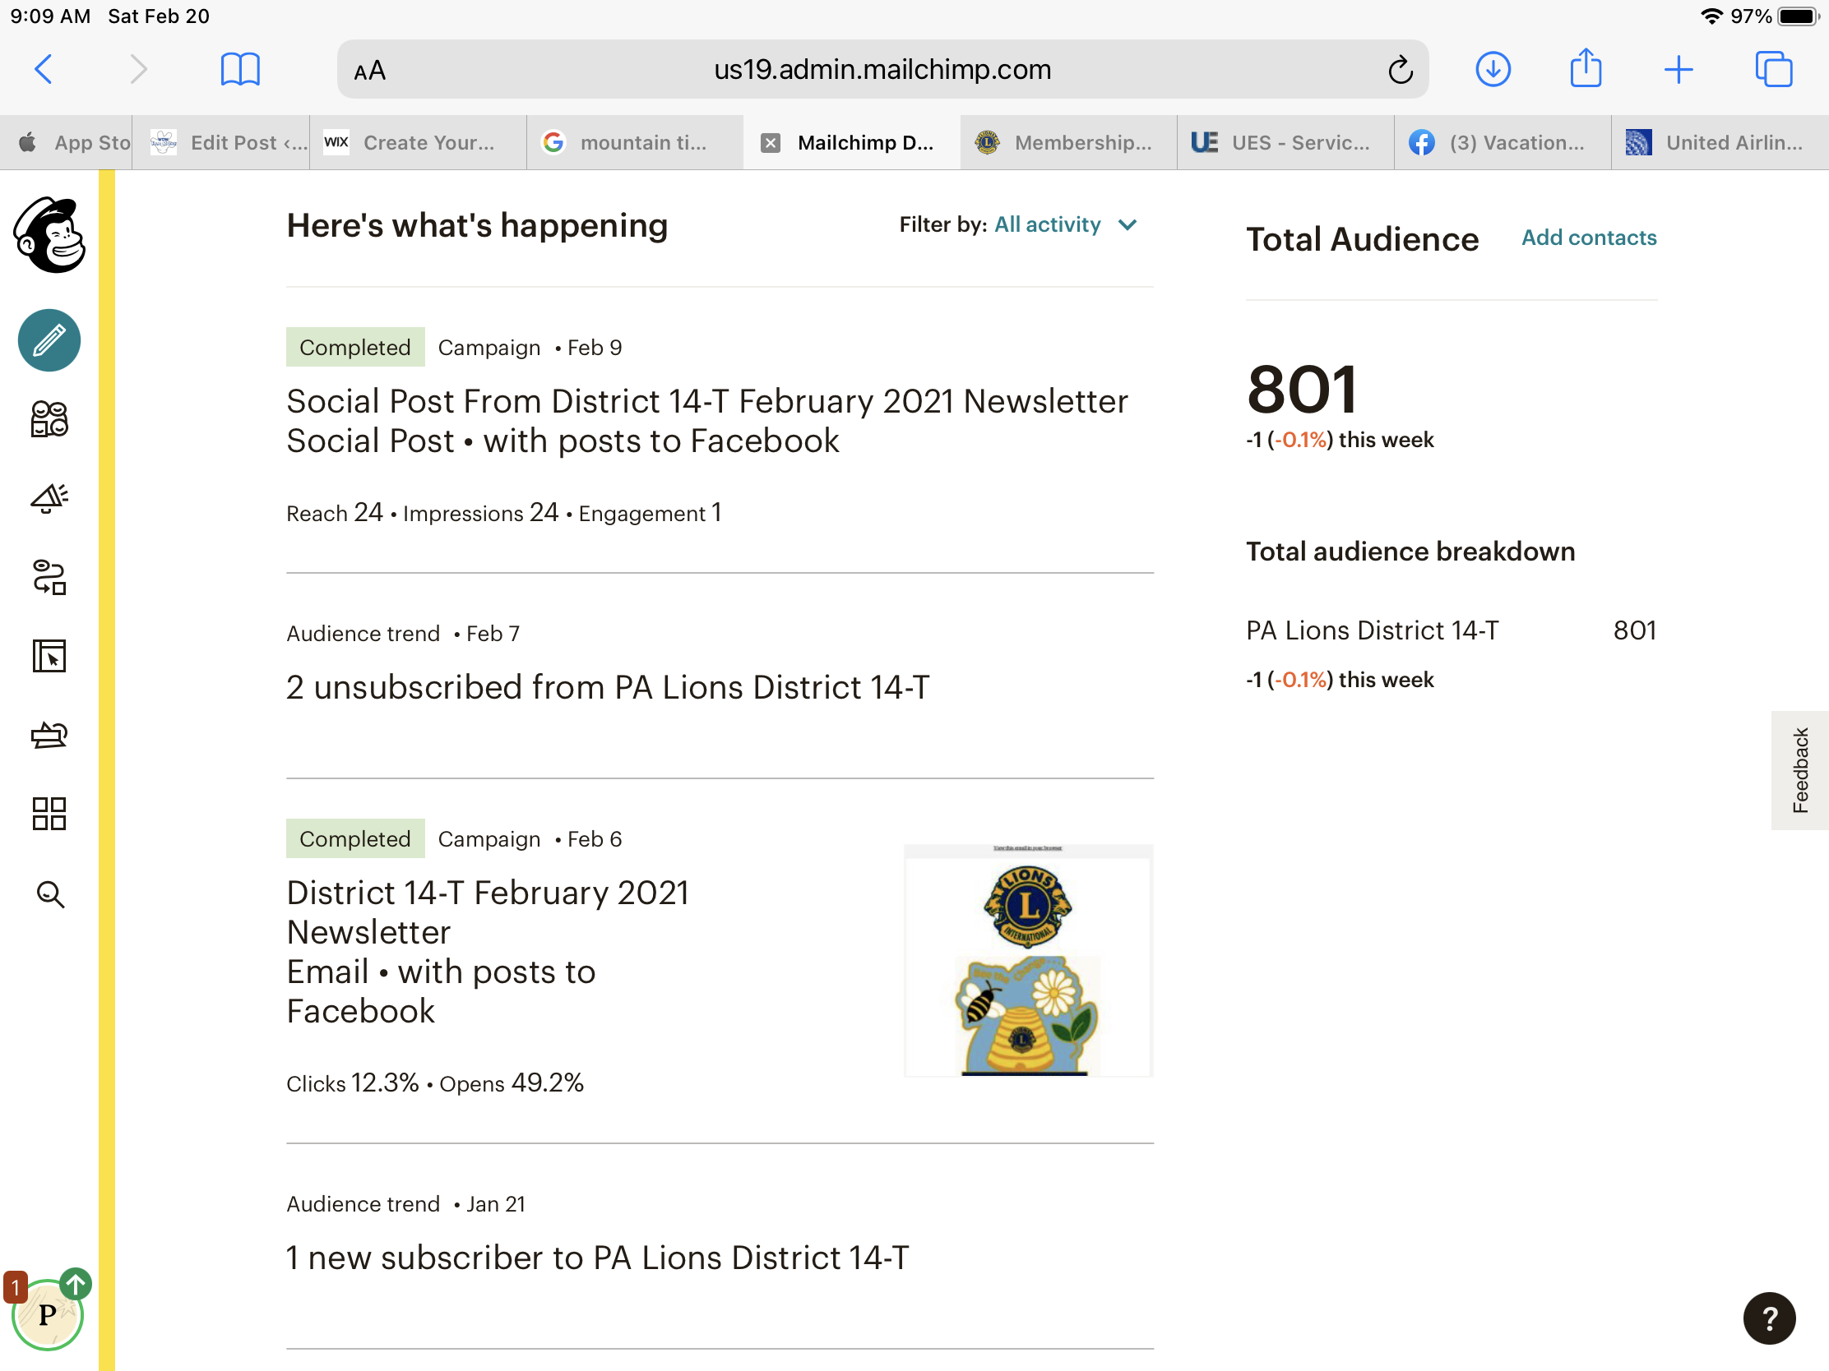
MailChimp - Dashboard

Slide 25




Virtual Meetings
Connecting when apart

Slide 26
Virtual Meetings
What do you use?
When do you use it?
Zoom
Facebook Rooms
Microsoft Teams
FaceTime
Skype
General Club Meeting
Club Board Meeting
Committee Meeting
District Cabinet Meeting
Training Session
District Convention
Social Event

Slide 27
Zoom
Getting Started
Tips
Create a free Zoom account
Schedule a meeting with just a few people
Conduct an informal meeting before using for a more more formal meeting
Try using the major features
Become familiar with free vs. paid features
As moderator, join meeting early
Ensure attendees have microphone and speakers
Try views – gallery, speaker
Adjust lighting (no background)
View usage videos
Use mute

Slide 28

Zoom - Where does it fit now?

Slide 29




File Storage
File Storage/Sharing

Slide 30


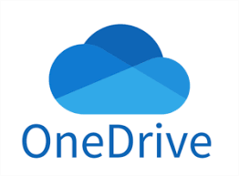


File Storage – Some Options
Google Drive
Amazon Drive
Microsoft OneDrive
Dropbox
Box

Slide 31
File Storage - Considerations
Storage apps also have options for photos (Amazon Photos)
Look at free storage limitations
Understand sharing and contribution
Mobile app access
Desktop synchronization
Security – be careful with member information!

Slide 32
File Storage – Sample Uses
Club and District documents
  Meeting agendas
  Meeting notes
  Bylaws, policies
  Fundraiser documents (spreadsheets, brochures)
  Member dues statements
  Other administrative
Club and district photos
  Share with members
  Social Media
  Website
  News media
  Event slideshows

Slide 33

Additional Tools
Some other tools I’ve used (or am trying)

Slide 34
Additional Tools
PayPal/Venmo – payments from Lions and public
Zeffy – event scheduling for non-profits including payment and ticketing
Doodle – polling for best meeting time
Websites – various tools

Slide 35
Summary
Review – what did you learn?
Take Action
Social Media
Google
MailChimp
Virtual Meetings
File Storage
Additional Tools
What are your top two takeaways that you will try or research?

Slide 36
Technology Workshop
Description
You have been elected as club President and want to rejuvenate your club
How might you prepare for your year by building a plan that includes technology?

Slide 37
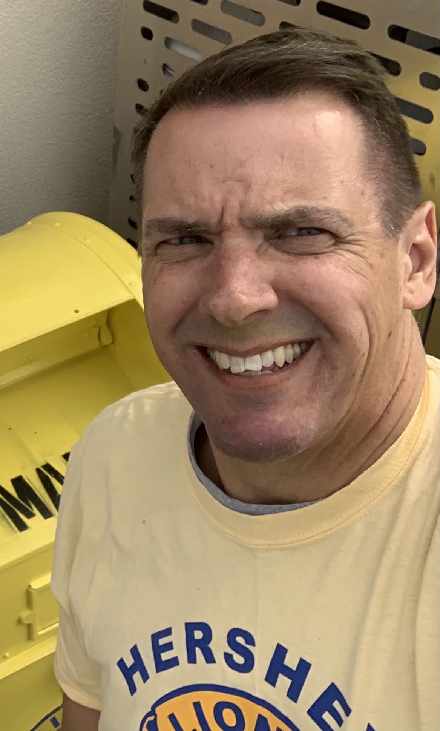
PDG John Mallonee
District 14-T
Hershey Lions Club
pdgjohn@hersheylions.org
Facebook – PDG Lion John Mallonee

